Slide 1
Course coordinator
Sangida Akter Saroni
Lecturer
Department of Accounting & Information
Systems
Bangabandhu Sheikh Mujibur Rahman Science & Technology University

Slide 2
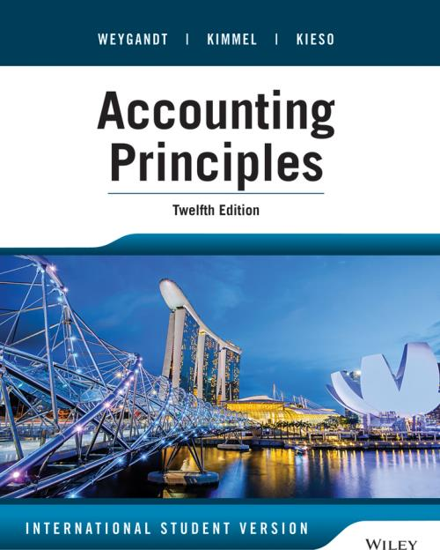
Book
By Weygandt, Kimmel, and Kieso

Slide 3
Accounting

Slide 4
What is accounting?
Accounting is an information system that identifies records and communicates economic events to the interested users.

Slide 5
History of Accounting
2500 B.C.
Historical accounting records have been found in ancient civilizations like the Egyptian, Roman, and Greek Empires as well as ancient Arabia. Back then, rulers kept accounting records for taxing and spending on public works.

Slide 6
1000 B.C. The Phoenicians created an alphabet with accounting so that they were not cheated through trades with ancient Egyptians. 500 B.C. Egyptians carried on with accounting records. They even invented the first bead and wire abacus.

Slide 7
423 B.C. The auditing profession was born to double check storehouses as to what came in and out the door. The reports accountants took were given orally, hence the name “auditor.” 1200 – 1493 The first requirement for businesses to keep accounting records spread across many of the Italian Republics in the 13th century.

Slide 8
1494 Luca Pacioli, the father of accounting, writes his famous paper “Summa de Arithmetica, Geometria, Proportioni et Proportionalita.” i.e. “Everything about Arithmetic, Geometry, and Proportion.” The first person to publish a work on double-entry bookkeeping, and introduced the field in Italy.

Slide 9
1500 – 1700 Double entry records had large and small innovations added. New terms like -invested capital -dividend distribution -managerial accounting, etc. came to light 1700 – 1900 During the Industrial Revolution, accounting really took a new form to be used in industrial companies.

Slide 10
1920 – 1940 The 20s accounting really became important to reduce the amount of fraud and scandals that were performed in businesses around the country. U.S. GAAP was developed shortly after by the American Institute of Certified Public Accountants (AICPA) and the Financial Accounting Standards Board (FASB) in the year 1939.

Slide 11
1940 – Present Since this time the AICPA and FASB have been working together with the Securities Exchange Commission (SEC) to develop accounting standards for business.

Slide 12

CHAPTER
1
Basics of Accounting

Slide 13
What is accounting?
Accounting is an information system that identifies records and communicates economic events to the interested users.

Slide 14
Three Activities of Accounting

Slide 15
Identification
To identify economic events, a company selects the economic events relevant to its business. Examples of economic events are the sale of snack chips by PepsiCo, providing of telephone services by Teletalk, and payment of wages by Ford Motor Company.

Slide 16
Recording, classifying and Summarizing
Once a company like PepsiCo identifies economic events, it records those events in order to provide a history of its financial activities. Recording consists of keeping a systematic, chronological diary of events, measured in dollars and cents. In recording, PepsiCo also classifies and summarizes economic events.

Slide 17
Communication
Finally, the enterprise communicates the collected information to interested users by means of accounting reports. The most common of these reports are called financial statements.

Slide 18
THE ACCOUNTING PROCESS
Communication
Identification
Recording
Accounting Reports
Gerald Trenholm
7 MacCauly Drive
Fredericton NB
2000
Prepare
accounting reports
SOFTBYTE
Annual Report
Select economic events
(transactions)
Record, classify,
and summarize
Analyse and interpret
for users

Slide 19
Interested users of accounting information
The financial information that users need depends upon the kinds of decision they make. Their diversified decision making and different need for information classify themselves in two broad groups.
They are-
Internal Users
External users

Slide 20
Internal Users
Internal Users of accounting information are those who plan, organize and run the business. They are-
Manager
Marketing manager
Production supervisor
Finance directors and
Company officers.

Slide 21
QUESTIONS ASKED BY INTERNAL USERS
What is the cost of manufacturing each unit of product?
Is cash sufficient to pay bills?
Can we afford to give employees pay raises this year?
Which product line is the most profitable?

Slide 22
External Users
External users are individuals and organizations outside a company who want financial information about the company.
Two common external users are-
Investor
creditors.

Slide 23
Moreover the external seekers of accounting information are- Taxing authority Regulatory agencies Customer labor unions etc.

Slide 24
QUESTIONS ASKED BY EXTERNAL USERS
How does the company compare in size and profitability with its competitors?
Is the company earning satisfactory income?
What do we do if they catch us?
Will the company be able to pay its debts as they come due?

Slide 25
Explaining the building blocks of accounting
Ethics
Assumptions
Principles

Slide 26
Ethics
The standards of conduct by which action are judged as right or wrong, honest or dishonest, fair and not fair are ethics.
Even effective financial reporting depends on sound ethical behavior.
When analyzing various ethics cases it is useful to apply the three steps.

Slide 27
ETHICS
Ethics
Standards of conduct
To Solve Ethical Dilemma
1. Recognize situation and ethical issues involved
2. Identify and analyse elements
3. Identify alternatives and weigh effects on stakeholders

Slide 28
Generally Accepted Accounting Principles
The accounting profession has developed a common set of standards that are generally accepted and universally practiced. This standards is called generally accepted accounting principles (GAAP).

Slide 29
Principles Cost/ Historical Cost Principle Fair Value Principle Matching principle The Full Disclosure Principle The Revenue Principle

Slide 30
Cost/ Historical Cost Principle
The cost principle is one of the basic underlying guidelines in accounting. It is also known as the historical cost principle. The cost principle requires that assets be recorded at the cash amount (or its equivalent) at the time that an asset is acquired.

Slide 31
Fair value principle
Fair value is a rational and unbiased estimate of the potential market price of a good, service, or asset.
Fair value principles states that assets and liabilities should be reported in fair value or market value.

Slide 32
Why cost? or Why fair value? FASB (Financial Accounting Standard Board) used two qualities that make accounting information useful for decision making— Reliability Relevance

Slide 33
Matching principle
The matching principles states that all of the expenses incurred in generating revenue should be identified or matched with the revenue generated for that period.

Slide 34
The Full Disclosure Principles
If certain information is important to an investor or lender using the financial statements, that information should be disclosed within the statement or in the notes to the statement. It is because of this basic accounting principle that numerous pages of "footnotes" are often attached to financial statements.

Slide 35
The Revenue Principles
This principles states that revenue should be recognized in the period when the sale is made, and specifies that revenues should be measured as the cash or cash equivalent received or to be receivable.
Revenues are recognized when they are-
Realized or earned
realizable

Slide 36
Assumptions
Assumptions provide a foundation for the accounting process.
Two main assumptions are:
the monetary unit assumption
the economic entity assumption
The Going Concern Postulates
The Accounting Period Postulates

Slide 37
The monetary unit assumption
The monetary unit assumption requires that companies include in the accounting records only transaction data that can be expressed in money terms.
It enables accounting to quantify (measure) economic events.
prevents the inclusion of some irrelevant information in the accounting records.

Slide 38
Economic Entity Assumption
The economic entity assumption requires that the activities of the entity be kept separate and distinct from the activities of its owner and all other economic entities.

Slide 39
Economic Entity An economic entity can be any organization or unit in society. Example: a company a governmental unit a municipality a school district, or a church

Slide 40
The Going Concern Postulates
The going concern postulates assumes that during and beyond the next fiscal period a company will complete its current plans, use its existing assets and continue to meet its financial obligations.

Slide 41
The Accounting Period Postulates
A cut-off date is fixed that enables interested users to assess the financial performance and other results about operation and flows of funds at regular intervals for short-term decision making.

Slide 42
BUSINESS ENTERPRISES
A business owned by one person is generally a proprietorship (owner’s equity).
A business owned by two or more persons associated as partners is a partnership (partners’ equity).
A business organized as a separate legal entity under corporation law and having ownership divided into transferable shares is called a corporation (shareholders’ equity).

Slide 43
BASIC ACCOUNTING EQUATION
The Basic Accounting Equation
Assets = Liabilities + Owner’s Equity

Slide 44
ASSETS
Assets are resources owned by a business.
Assets has the capacity to provide future services or benefits
They are things of value used in carrying out such activities as production and exchange.
These service potential or future economic benefit eventually results in cash inflows.

Slide 45
LIABILITIES
Liabilities are claims against assets.
They are existing debts and obligations.
These economic activities result in payables

Slide 46
OWNER’S EQUITY
Owner’s Equity is equal to total assets minus total liabilities.
Owner’s Equity represents the ownership claim on total assets.
Subdivisions of Owner’s Equity:
1. Capital- (Increase)
2. Drawings- (decrease)
3. Revenues- (Increase)
4. Expenses- (decrease)

Slide 47
INVESTMENTS BY OWNERS
Investments by owner are the assets put into the business by the owner.
These investments in the business increase owner’s equity.

Slide 48
DRAWINGS
Drawings are withdrawals of cash or other assets by the owner for personal use.
Drawings decrease total owner’s equity.

Slide 49
REVENUES
Revenues are the gross increases in owner’s equity resulting from business activities entered into for the purpose of earning income.
Revenues may result from sale of merchandise, performance of services, rental of property, or lending of money.
Revenues usually result in an increase in an asset.

Slide 50
EXPENSES
Expenses are the decreases in owner’s equity that result from operating the business.
Expenses are the cost of assets consumed or services used in the process of earning revenue.
Examples of expenses include utility expense, rent expense, and supplies expense.

Slide 51
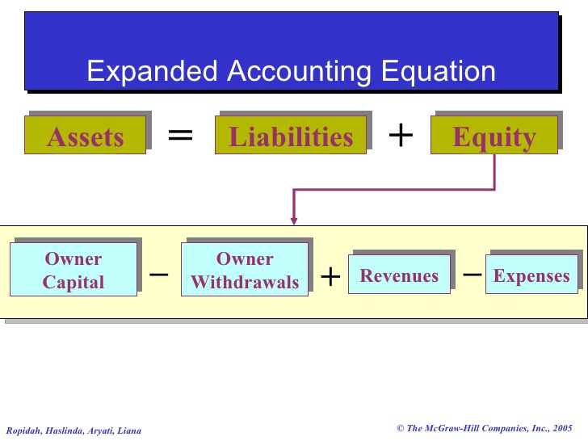

Slide 52
What is a 'Transaction'
The term financial transaction is viewed as a business dealing, which involves the exchange of goods or services for value between two or more parties, firms or account.
Any event which has some monetary impact on the financial statement of the business is called as a transaction. It may result in it in the movement of value from one person to another.
Example, Softbyte purchases computer equipment for $7,000 cash.

Slide 53
Transaction Vs Event
Definition | A transaction is an agreement between a buyer and a seller to exchange goods, services or financial instruments. | The normal life occurrences or series of activities happening in every stage of our life
Change in financial position | Results in change in the financial position of the company. | May or may not result in change in financial position of the company.
Scope | Narrow | Wide
Money measurement | The financial changes caused by transactions must be measurable in terms of money. | Financial changes caused by events may or may not be measurable in terms of money.
Transfer of substances | As a consequence of transactions transfer of goods or service is a must. | Transfer of goods or services may or may not occur for an event.

Slide 54
Transaction Vs Event
Record | Every transaction must be recorded in the books of accounts; otherwise accurate results cannot be ascertained from the books of accounts. | It is not necessary that every event will be recorded in the books of accounts.
Evidence | Business transactions must be supported by evidence. | Transactions related to events are not always supported by evidence.
Relation | All transactions are events. | All events are not transactions.
parties | In the case of transaction two parties are must. | It may or may not require two parties for the occurrence of an event.

Slide 55
What are the characteristics of Transaction?

Slide 56
Nature and Features of Accounting Transactions
Change in financial position
Measurable in terms of money
Dual aspect
Invisible transactions
Historical events
Evidence

Slide 57
Types / Classification of Accounting Transactions
On the basis of exchange of cash
(a) Cash transactions. (b) Credit transactions. (c) Noncash transactions.
On the basis of institutional relationship
External transactions
Internal transactions.

Slide 58
Types / Classification of Accounting Transactions
On the basis of visibility
Visible transactions
Invisible transactions.
On the basis of objectivity
Business transactions.
Non-business or non-trading transactions.
Personal transactions.

Slide 59
TRANSACTION ANALYSIS

Slide 60
TRANSACTION 1
On September 1, he invests $15,000 cash in the business, which he names Softbyte.

Slide 61
TRANSACTION 2
Softbyte purchases computer equipment for $7,000 cash.

Slide 62
TRANSACTION 3
Softbyte purchases computer paper and supplies expected to last several months from Acme Supply Company for $1,600 on account.

Slide 63
TRANSACTION 4
Softbyte receives $1,200 cash from customers for programming services it has provided.

Slide 64
TRANSACTION 5
Softbyte receives a bill for $250 for advertising its business but pays the bill on a later date.

Slide 65
TRANSACTION 6
Softbyte provides programming services of $3,500 for customers and receives cash of $1,500, with the balance payable on account.

Slide 66
TRANSACTION 7
Expenses paid in cash for September are store rent, $600, salaries of employees, $900, and utilities, $200.

Slide 67
TRANSACTION 8
Softbyte pays its advertising bill of $250 in cash.

Slide 68
TRANSACTION 9
The sum of $600 in cash is received from customers who have previously been billed for services in Transaction 6.

Slide 69
TRANSACTION 10
Marc Doucet withdraws $1,300 in cash from the business for his personal use.

Slide 70
FINANCIAL STATEMENTS
After transactions are identified, recorded, and summarized, five financial statements are prepared from the summarized accounting data:
1. An income statement presents the revenues and expenses and resulting net income or net loss for a specific period of time.
2. An owner’s equity statement summarizes the changes in owner’s equity for a specific period of time.

Slide 71
FINANCIAL STATEMENTS
3. A balance sheet reports the assets, liabilities, and owner’s equity at a specific date.
4. A statement of cash flows summarizes information about the cash inflows (receipts) and outflows (payments) for a specific period of time.
5. Notes

Slide 72
Softbyte’s Transactions
On September 1, he invests $15,000 cash in the business, which he names Softbyte.
Softbyte purchases computer equipment for $7,000 cash.
Softbyte purchases computer paper and supplies expected to last several months from Acme Supply Company for $1,600 on account.
Softbyte receives $1,200 cash from customers for programming services it has provided.
Softbyte receives a bill for $250 for advertising its business but pays the bill on a later date.......................................

Slide 73
Softbyte’s Transactions
Softbyte provides programming services of $3,500 for customers and receives cash of $1,500, with the balance payable on account.
Expenses paid in cash for September are store rent, $600, salaries of employees, $900, and utilities, $200.
Softbyte pays its advertising bill of $250 in cash.
The sum of $600 in cash is received from customers who have previously been billed for services in Transaction 6.
Marc Doucet withdraws $1,300 in cash from the business for his personal use.

Slide 74
No | Assets |  |  |  |  | Liability | Owner’s Equity
 | Cash | A/R | Equi | Supp | = | A/p | Cap | + Rev | - Exp | - Draw
1 | +15000 |  |  |  |  |  | +15000
2 | -7000 |  | +7000
3 |  |  |  | +1600 |  | +1600
4 | +1200 |  |  |  |  |  |  | +1200
5 |  |  |  |  |  | +250 |  |  | -250
6 | +1500 | +2000 |  |  |  |  |  | +3500
7 | -600 -900 -200 |  |  |  |  |  |  |  | -600 -900 -200
8 | -250 |  |  |  |  | -250
9 | +600 | -600
10 | -1300 |  |  |  |  |  |  |  |  | -1300
Total | $8050 | $1400 | $7000 | $1600 | = | $1600 | $15000 | $4700 | $1950 | $1300

Slide 75
Financial Statements of Softbyte

Slide 76
Financial Statements of Softbyte

Slide 77
Financial Statements of Softbyte

Slide 78
Financial Statements of Softbyte

